Slide 1
SPAM MAIL DETECTION USING MACHINE LEARNING
K SUPRIYA -

Slide 2

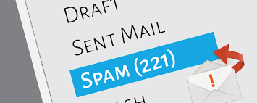
INTRODUCTION
Spam email is unwanted junk email sent out in bulk to a random recipient list. There are different ways that spam can be sent. It could be sent by humans but the most common way is sending them through a network of computers called botnets (spambots). To solve this problem of spotting or detecting a Spam Email, there are various Machine Learning techniques in both Supervised and Unsupervised learning.

Slide 3
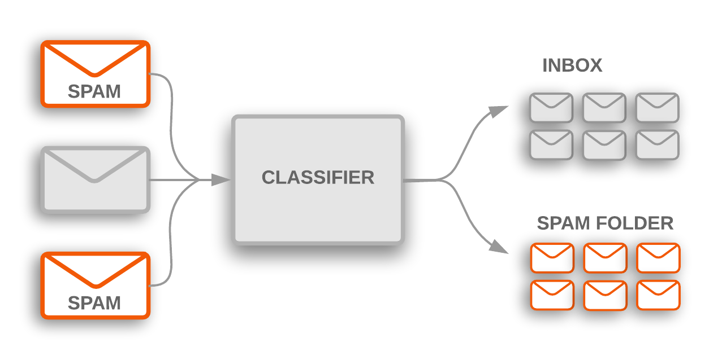
WHAT WE AIM TO DO?
Through this project we aim to detect or spot spam emails and classify them using different Machine Learning algorithms. We would also compare the algorithms and check the best algorithm which has a better precision and accuracy value.
For this particular project we would be focusing on using three Supervised Machine Learning techniques:
KNN or K-nearest neighbors
SVM or Support vector machine
Decision Trees

Slide 4
LITERATURE SURVEY
Machine Learning Techniques for Spam Detection in Email and IoT Platforms: Analysis and Research Challenges.
A detailed comparison including different parameters like accuracy, precision, recall have been discussed in depth. Both Supervised and Unsupervised Machine Learning techniques are used and they are compared based on their accuracy, precision value and other important parameters.
It also provides a comprehension or understanding of future spam detection or filtering methods that are open to research and provide better security email platforms. Finally the paper gives us research gaps, challenges of spam detection and also future space and area of research.

Slide 5
LITERATURE SURVEY
2. A Comparative Analysis of SMS Spam Detection employing Machine Learning Methods.
The aim of this study is to detect spam message that are a threat
In this paper, studies on SMS spam problems to perform a better accuracy using several different techniques such as Support Vector Machine, K-Nearest Neighbor, Naïve Bayes, Random Forest, Logistic Regression and some more are performed.
The result indicated that Support Vector Machine achieved the highest accuracy of 99%, indicating it might be useful as an effective machine learning system for future research.

Slide 6
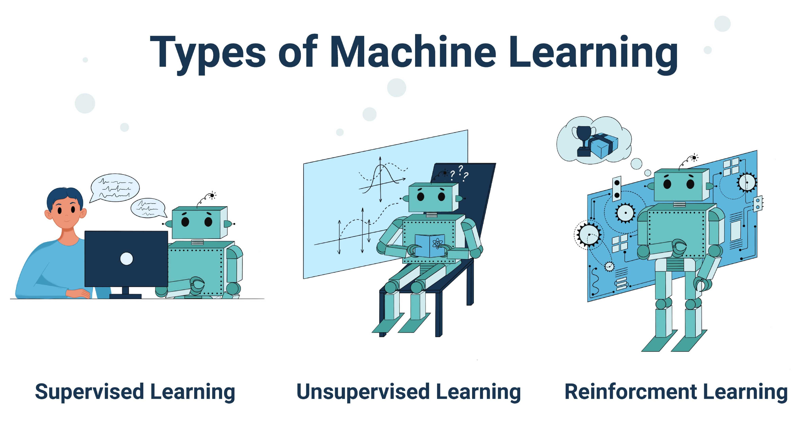
TYPES OF MACHINE LEARNING

Slide 7
MODELS USED
K-NEAREST NEIGHBORS:
KNN (K-Nearest Neighbors) is one of the simplest supervised learning algorithms. “K” stands for number of data set items that are considered for the classification.

Slide 8
MODELS USED
SUPPORT VECTOR MACHINE:
It is a supervised machine learning algorithm that works by finding a hyper plane that classifies the dataset into different classes.

Slide 9
MODELS USED
DECISION TREE:
A decision tree is a type of supervised machine learning used to categorize or make predictions based on how a previous set of questions were answered.

Slide 10

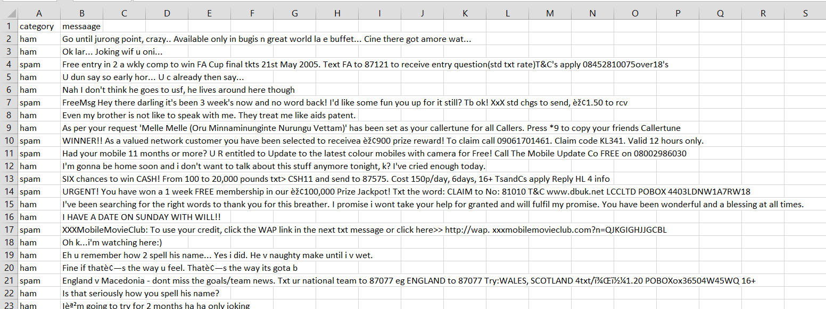
IMPLEMENTATION
DATASET AND SOFTWARE:
We have used ANACONDA and Jupyter Notebook to run and
simulate the code and produce the output and graphs.

Slide 11
IMPLEMENTATION
LIBRARIES/ MODULES USED:

Slide 12
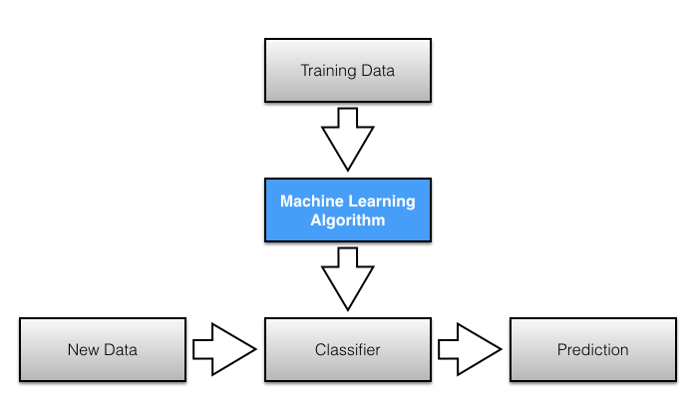
IMPLEMENTATION
DATA PREPROCESSING:
The original dataset when imported consists of 5 columns. Out of the five columns, three columns are unnamed or not named and they had null values in them. These three columns don’t have any use so we have removed them.
TRAINING AND TESTING:
The ‘train_test_split’ function is used and
the train:test ratio is taken to be 8:2

Slide 13
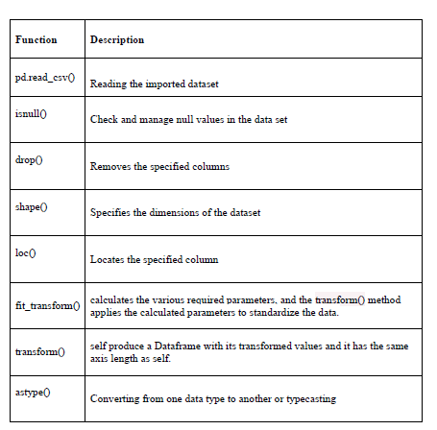
IMPLEMENTATION
FUNCTIONS USED AND THEIR DESCRIPTION:

Slide 14
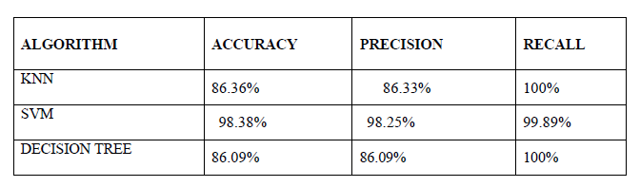
OUTPUT/RESULT
COMPARISION OF THE DIFFERENT MODELS:

Slide 15
OUTPUT/RESULT
COMPARISION OF THE DIFFERENT MODELS:

Slide 16
CONCLUSION
We can conclude or infer from the above table that the most accurate model here is SVM.SVM also has the best precision value and both KNN and decision tree have the best recall value. Through this project a comprehensive analysis of various classifiers was implemented on a common dataset. The results were compared based accuracy, precision, and recall score. Models like SVM are a good example with high accuracy.

